Slide 1
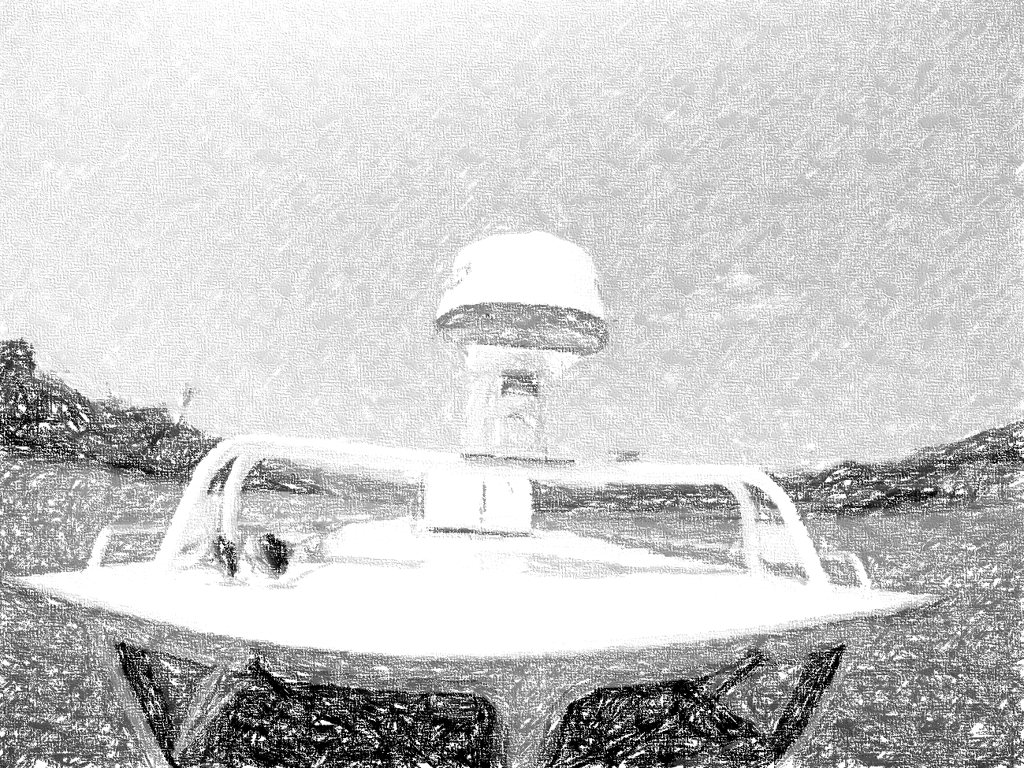


Autonomous Water Taxi
System Design Review
By: AutoPirates
Date: 20th Jan, 2016
Project Sponsors:
Team B: Tushar, Shiyu, Bikramjot, Tae-Hyung, William

Slide 2
Content
Current Status
Work Plan and Road Ahead
System-level requirements
Key Challenges

Slide 3
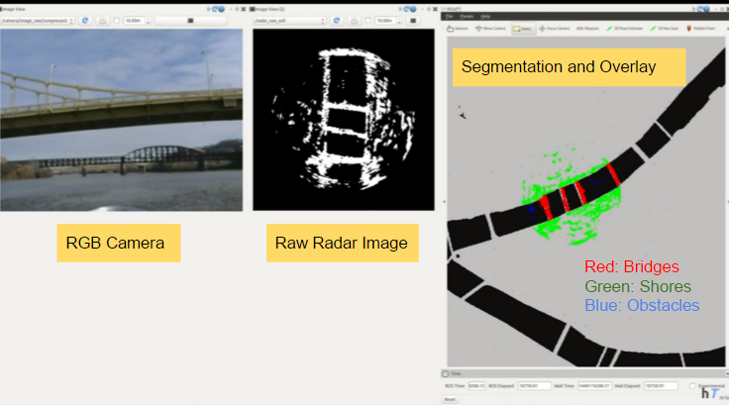
Current Status: Perception

Slide 4
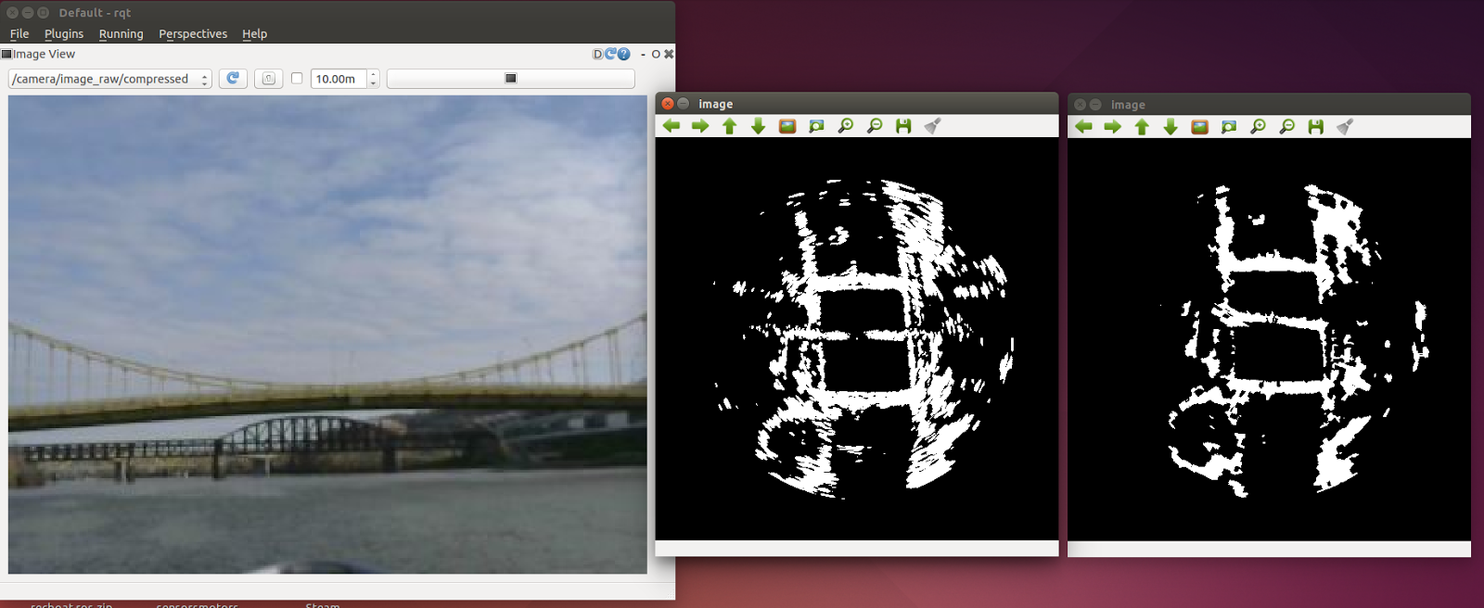
Current Status: Perception | Filter
Binomial Probabilistic Filter
Binomial Probabilistic Filter
Before Filtering
After Filtering

Slide 5
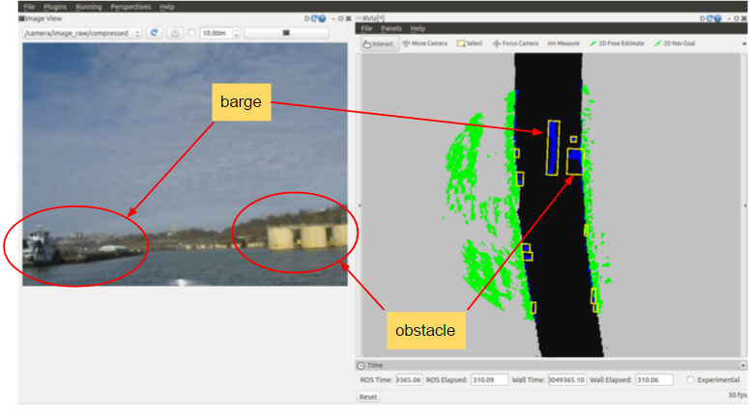
Current Status: Perception | Detection

Slide 6
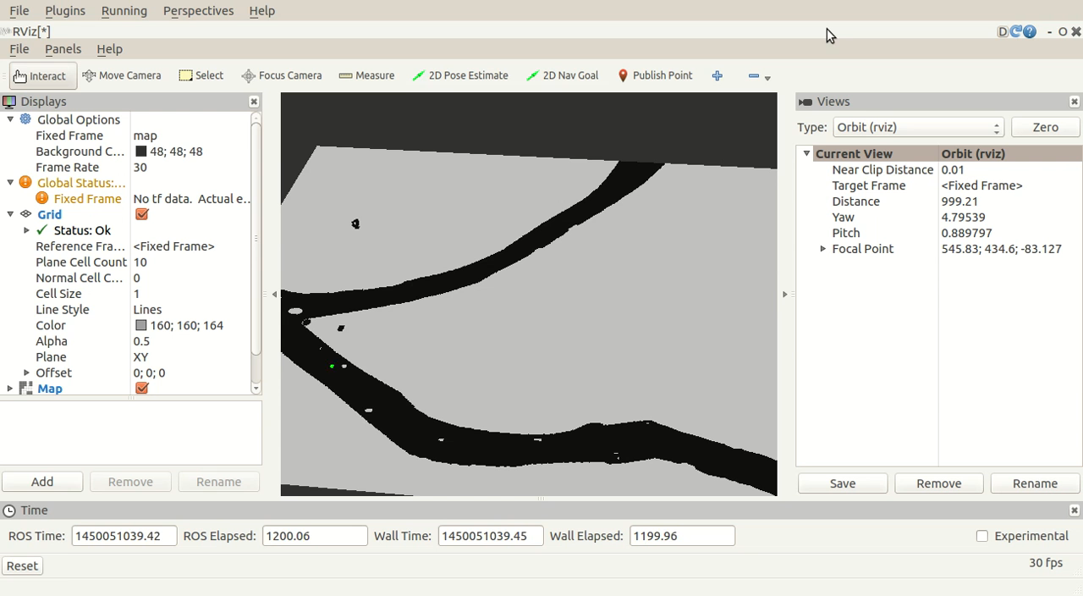
Current Status: Path Planning | Simulator

Slide 7
Functional Architecture: What all is done and what is
Pending
Log Data
No
*Not in planned scope
Destination reached?
Get current location and localize
Plan route from current location to destination
Send commands to controller
Autonomously sail to destination
IMU/GPS
Yes
User Input
Get destination
Destination
Planning
Acquire data from Sensors
Filter data
Detect Static Obstacles
OCU
Radar
Perception
Log Data
Log Playback

Slide 8
Work Plan leading to Spring Validation Experiments
Progress Review | Field Test | Milestones
7 | 3 | Generate New Map with bridges pylons Integrate RADAR data with the Path Planning Algorithm Initial integration with incremental planning
8 | 4 | Test path planning using incremental planner Write code to generate fake obstacles in software to test path planning Buffer Test -- Iterate the flaws identified in Field Test 3
9 | 5 | Optimize costmap to keep boat at desired locations (like center of rivers)
10 | 6 | Update the code to follow the rules of the river
11,12 | 7, 8 | Improve the overall subsystem and test possible problems Improve performace of the overall system

Slide 9
Spring Validation Experiments: Script for final demo
Step ID | Step Description | Success Criteria | Conditions
SV.1 | Get the boat on the river | Location: center of width | Start Location: Monongahela River (South side works 40.4321453,-79.974770) Equipment /Arrangements: Boat, Radar, IMU/GPS, Fuel, Laptop in boat, Camera to record video, safety driver People on boat: Driver, Team, Prof Dolan and Prof Dimi
SV.2 | Keep 2 static obstacles in the path and add 2 obstacles on simulator | Size more than 2mx2mx2m
SV.3 | Switch on the engines and start AutoPirates autonomous system | The system starts successfully
SV.4 | Enter the destination through OCU | OCU takes the location correctly
SV.5 | The boat navigates autonomously and avoids obstacles | Boat avoids at least 3 obstacles
SV.6 | The boat arrives the destination | Boat arrives to destination (15 mts radius)
SV.7 | Show logged file | Play back logged data
SV.8 | Turn off the autonomous system and engine | System switches off without any error

Slide 10
Budget Allocation
Hardware/Equipment/Budget provided by the sponsor (NREC)
S.No | Part | Part Name | Quantity
1 | Boat | 2015 SeaHawk OS 2700S | 1
2 | Radar | SimRad 4G FMCW Radar | 1
3 | Lidar | Velodyne VLP-16 | 1
4 | IMU/GPS | Novatel SPAN with IMU positioning | 1
5 | Laptop | Dell i7 | 5
6 | Proprietary Boards | SBC and Microcontroller boards | 2
7 | Trails for testing | $800 per trial | 25 (trails)
From RI Budget $4000
S.No | Name | Description | Qty | Cost | Total | Spent | Left
1 | Transportation | Travel to NREC (5 people) | 64 | 25 | 1600 | 50 | 1550
2 | Videography | Professional video for NREC | 1 | 500 | 500 | 0 | 500
3 | Backup for Trails | Incase we run out of allotted 25 trails | 2 | 800 | 1600 | 0 | 1600
4 | Miscellaneous | To buy camera, contraption, books | 1 | 300 | 300 | 54 | 246
Available
3896

Slide 11
Key Challenges
S.No | Challenges
1 | Integrating subsystems
2 | Fast Incremental Planning
3 | Weather
4 | Handling boundary cases (like if there is no path between start and goal)
5 | Following ‘Rules of Road’
6 | Handling noise from Radar data

Slide 12
Questions

Slide 13

Current Status

